Slide 1





ParkWhere?
Done by:
(◕‿◕✿)DoUKnowDaWae༼ つ ◕_◕ ༽つ
Group Members:
Choo Pei Yan
Yeo Yao Cong
Lee Shun Hui
Edena Teo Yi Ning
Khoo Chee Kuang

Slide 2
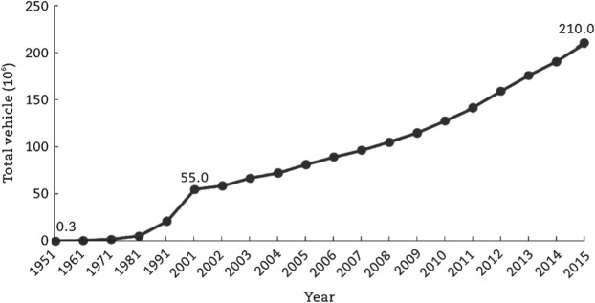
Problem
Increasing number of vehicles over the years
Current applications tackles the navigation factors
BUT
Drivers spent 17 hours per year trying to find a parking spot
Not the “arriving” factors
Forced to wait or drive around until a lot is available.
Negatively impact a driver’s emotional state
Increase risks of accidents
Long Travelling Time
Decreased chances in finding a parking spot
Current apps lack the function of carpark tracking or additional car park info indications
They only point towards the general area of the user’s input
No clue as to where you can stop your car

Slide 3
Approach
Provide users with car park info via search/maps
Searching via the map allows users to dynamically search for car parks in a specific area
Provides interconnectivity between users on a platform for reviews and ratings of car parks.
Schedule a Plan!
If the user is planning to leave later in the afternoon, our application notify users to check near departure time via telegram notifications!

Slide 4
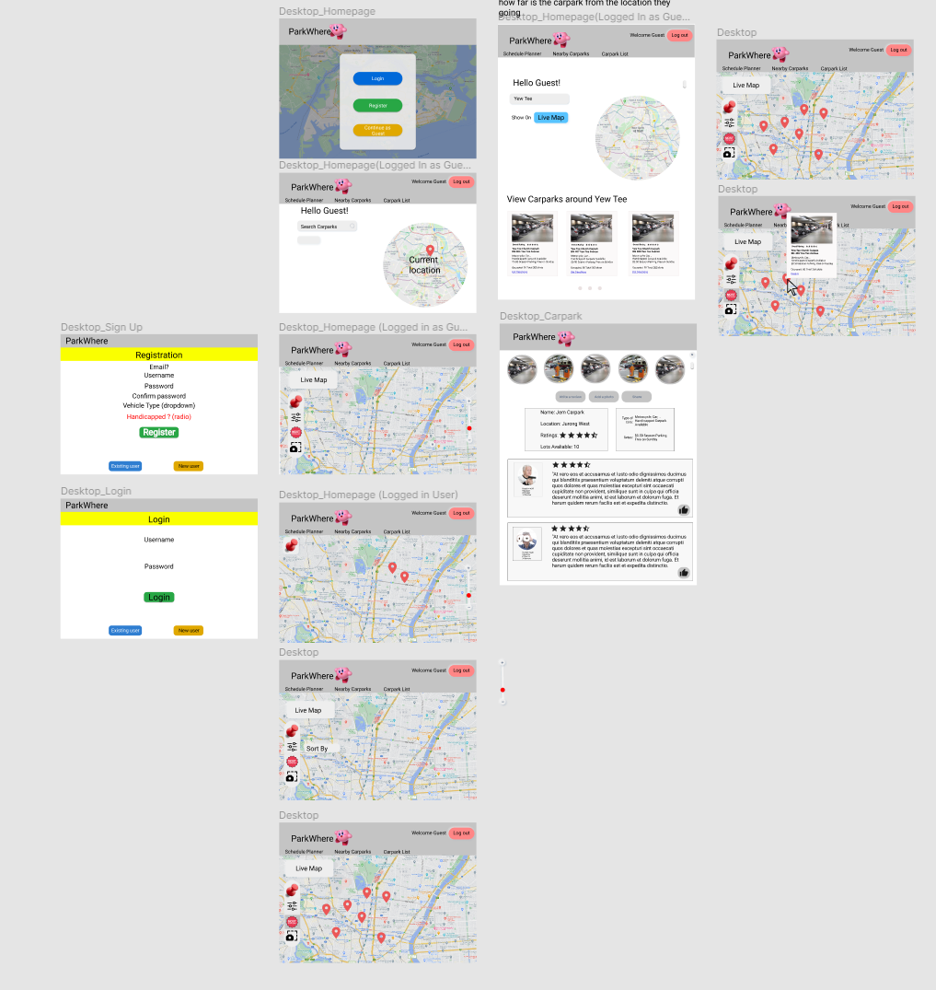
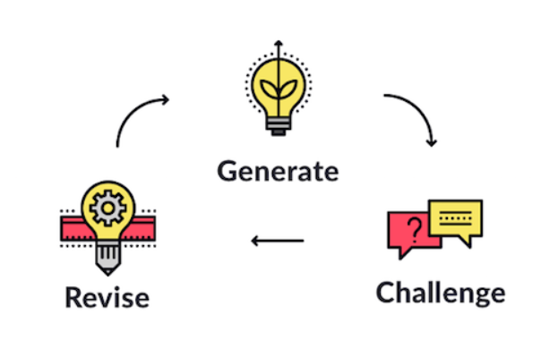
Ideation
Design / Implementation
Figma
Screen Prototyping
Language Used:
HTML/JS/CSS ( Front End )
PHP ( Back End )
MySQL ( Database )
Data Stores:
Localhost ( Server )
Json Files - rates.json ( took from Github )
InnoDB -- MySQL 8.0.21
External
Bitbucket repository
Anchored by Sourcetree
Not Program Related
Notion
A checklist to track our to-dos
Problem Statement
1) Derived from our group in-house
drivers
2) Common problem for drivers around Singapore

Slide 5

Ideation
Styling
Libraries Used:
Animation:
https://github.com/protonet/jquery.inview
https://animate.style/
Our logo is a personified version of Earth
-> Our Earth has problems
-> Parking is a societal problem
-> Solving problems is crucial because
Earth is our
HOME
Symbolises “Not-Knowing” where to park is a common problem, and our goal is to solve the parking issues.
Fonts Used:
Google Font Library
Rubik - Main texts - tied to the body tag
Karla - Headers - tied to Headers/Titles
Sonsie One - Logo
Colours Scheme :
Double Split Complementary
Different Colours have different functionalities
e.g. Yellow signifies buttons that have restricted functions for Guest Users!

Slide 6
Ideation
How is Javascript used in our App?
Insert as CDN
(Content Delivery Network)
Similar to Vue,
Bootstrap, Axios
APIs Used:
Google: Maps, Geolocation, Places
Parking:
Static: URA Rates, HDB, OneMap
Dynamic: DataMall Availability
Others: Images Search - Powered by Serpstack
Links:
Down in the description below.
Javascript - XHR calls
So… What do we call?
PHP Files
Date/Notification Object
HTML DOM
APIs
JQuery
PHP API Call - Curl()
JavaScript XMLHTTPRequest() - XHR!
Notes:
https://github.com/Tzyinc/sg-carpark-bot (jsonfile)
http://datamall2.mytransport.sg/ltaodataservice/Cahttps://github.com/Tzyinc/sg-carpark-bot (jsonfile)
http://datamall2.mytransport.sg/ltaodataservice/CarParkAvailabilityv2
https://www.ura.gov.sg/uraDataService/invokeUraDS?service=Car_Park_Details
https://data.gov.sg/api/action/datastore_search?resource_id=139a3035-e624-4f56-b63f-89ae28d4ae4c&limit=9999rParkAvailabilityv2
https://www.ura.gov.sg/uraDataService/invokeUraDS?service=Car_Park_Details
https://data.gov.sg/api/action/datastore_search?resource_id=139a3035-e624-4f56-b63f-89ae28d4ae4c&limit=9999
https://serpstack.com/
https://developers.google.com/places/web-service/autocomplete
https://developers.google.com/maps/documentation/javascript/overview
https://docs.onemap.sg/

Slide 7




Beyond the Labs
Python Telegram Bot
Retrieve Information from Database
Set a Timer for users (Reminder)
Activated through a random code sent to the users!
( Through the website )
SourceTree & BitBucket
Platform for Code Sharing!
Google Maps Api
A Dynamic Pin where user can freely drag on the Google Map that scans for nearby Carparks
Animations
JQuery - inview
Animate.css

Slide 8
Screen Flow
Set Reminder to check for car parks near departure time!
Know of a Carpark that others don’t?
SHARE IT!!
NO
Register/Login
Login as Guest
Leaving
Soon?
Search for
Carparks
at the user’s
destination
YES
A Carpark is bad? Leave a review!!!!
View for Availability, Rates and Check for Ratings!!!
OFF YOU GO!!!

Slide 9




(◕‿◕✿)DoUKnowDaWae༼ つ ◕_◕ ༽つ
We will now proceed on to the application demonstration!!!

